Slide 1

Operation Management
Rinki raghuwanshi
1/11/2021

Slide 2
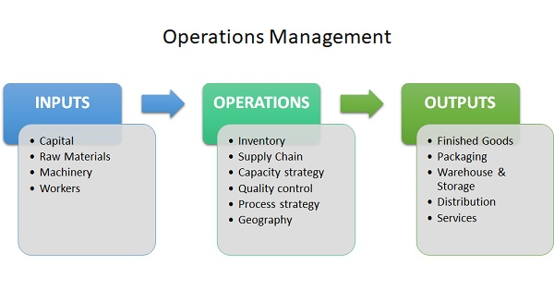
Introduction to operating system
Operations management is the management of processes that transform inputs into goods and services that add value for the customer.

Slide 3
Content
What is Operation Management?
Importance of Operation Management.
The Goal of Operations Management
Types of Operational Management
What are the roles of Operation Management?
How OM different from PM?
History of Operation Management
Key points

Slide 4

What is Operations Management?
Operations management is the management of processes that transform inputs into goods and services that add value for the customer.

Slide 5
IMPORTANCE OF OPERATING SYSTEM
Production Efficiency
Profit Maximization
The Satisfaction of the Customers
Effective Utilization of the Resources
Management of Inventory
Capacity Management
Scheduling Management

Slide 6
The Goal of Operations Management
The goal of operations management is to maximize efficiency while producing goods and services that effectively fulfill customer needs.
For example, if an organization makes furniture, some of the operations management decisions involve the following:
purchasing wood and fabric,
hiring and training workers,
location and layout of the furniture factory,
purchase cutting tools and other fabrication equipment.

Slide 7
Types of Operational Managememt
Every business operates along five basic focus dimensions:
Finance
Customers
Internal processes
Learning
Innovation.

Slide 8
What are the role of Operation Management?
Operations managers are responsible for managing activities that are part of the production of goods and services. Their direct responsibilities include managing both the operations process, embracing design, planning, control, performance improvement, and operations strategy.

Slide 9
How OM different from PM?
Operations Management refers to the part of management concerned with the production and delivery of goods and services.
Production Management connotes the administration of the range of activities belonging to the creation of products.

Slide 10

History of Operation Management
The idea of operations management began in the eighteenth century as manufacturing management. An economist, Adam Smith, realized that specialization of labor could be very beneficial to any organizations economy

Slide 11
Functions and Roles in Operations Management -Planning and implementing manufacturing plants. -Managing projects. -Planning information systems. -Helping to design and develop products and services. -Managing inventory through the supply chain. -Managing delivery to customers in a timely manner. -Optimizing quality control.

Slide 12
Thank You
LinkedIn linkedin.com/in/rinki-raghuwanshi-094a971a0
Email rinkiraghu2301@gmail.com
Phone 8349649673

